Slide 1
DATA INTERPRETATION

Slide 2
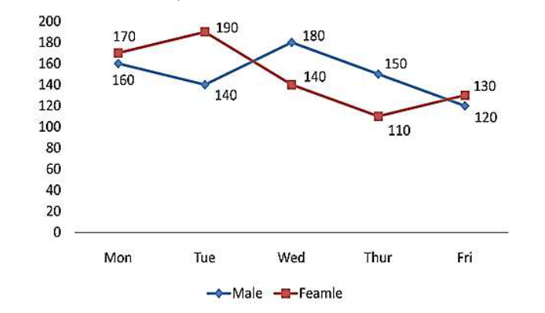
Directions (Q1 to 5): Study the following information carefully and answer the questions given beside:
Q1. Find the ratio of the total number of males visited the place on Tuesday and Thursday together to the total number of females visited the place on Monday and Friday together?
29: 30
30: 29
25: 26
26: 25
None of these
Number of male and number of females are given, they are visiting a place from Monday to Friday.
Notes:
Correct Answer: Option A
Level: Easy (Compulsory)

Slide 3
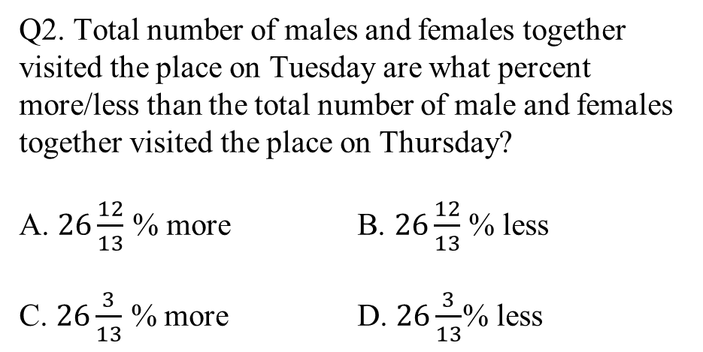
Directions (Q1 to 5): Study the following information carefully and answer the questions given beside:
Q2. Total number of males and females together visited the place on Tuesday are what percent more/less than the total number of male and females together visited the place on Thursday?
A. $26\frac{12}{13}$ % more B. $26\frac{12}{13}$ % less
C. $26\frac{3}{13}$ % more D. $26\frac{3}{13}$% less
Number of male and number of females are given, they are visiting a place from Monday to Friday.
Notes:
Correct Answer: Option A
Level: Easy (Compulsory)

Slide 4
Directions (Q1 to 5): Study the following information carefully and answer the questions given beside:
Q3. Find the difference between the total number of females visited the place from Monday to
Wednesday and the total number of males visited the place from Wednesday to Friday?
A. 30
B. 60
C. 40
D. 50
Number of male and number of females are given, they are visiting a place from Monday to Friday.
Notes:
Correct Answer: Option D
Level: Easy (Compulsory)

Slide 5
Directions (Q1 to 5): Study the following information carefully and answer the questions given beside:
Q4. If on Saturday number of males and number of females increased by 25% and 20% respectively
as compared to that on Friday then find the total number of males and females together visited
the place on Saturday?
A. 196
B. 306
C. 316
D. 206
Number of male and number of females are given, they are visiting a place from Monday to Friday.
Notes:
Correct Answer: Option B
Level: Easy (Compulsory)

Slide 6
Directions (Q1 to 5): Study the following information carefully and answer the questions given beside:
Q5. Total number of males and females visited the place on Monday and Tuesday together is how
much more than the total number of males and females visited the place on Thursday and
Friday together?
A. 175
B. 125
C. 150
D. 160
Number of male and number of females are given, they are visiting a place from Monday to Friday.
Notes:
Correct Answer: Option C
Level: Easy (Optional)

Slide 7
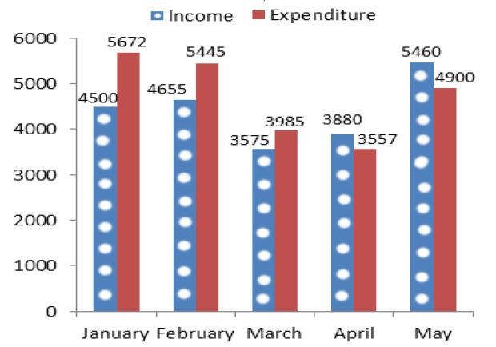
Directions: (Q 6- 10) : Study the following bar chart carefully and answer the questions given
The data given below shows the amount of salary received by Kartik and the total expenditure for Five months. If his salary falls short of the expenditure in any month, he borrows the required money to meet the expenditure from his friend Arun. If he saves some money in any month he gives that complete amount to Arun.
Q6. What is the total amount of money that Kartik owes his friend Arun at the end of the month of May?
A. Rs. 1529
B. Rs. 1489
C. Rs. 1389
D. Rs. 1469
Notes:
Correct Answer: Option B
Level: Moderate (Compulsory)

Slide 8
Directions: (Q 6- 10) : Study the following bar chart carefully and answer the questions given
The data given below shows the amount of salary received by Kartik and the total expenditure for Five months. If his salary falls short of the expenditure in any month, he borrows the required money to meet the expenditure from his friend Arun. If he saves some money in any month he gives that complete amount to Arun.
Q7. During these five months the total amount of money returned by Kartik to Arun is what percent of the total amount of money he borrowed from him?
A. 36.56%
B. 38.56%
C. 37.23%
D. 39.13%
Notes:
Correct Answer: Option C
Level: Moderate (Compulsory)

Slide 9
Directions: (Q 6- 10) : Study the following bar chart carefully and answer the questions given
The data given below shows the amount of salary received by Kartik and the total expenditure for Five months. If his salary falls short of the expenditure in any month, he borrows the required money to meet the expenditure from his friend Arun. If he saves some money in any month he gives that complete amount to Arun.
Q8. What is the average expenditure of Kartik from January to May?
A. Rs. 4788
B. Rs. 4789.6
C. Rs. 4667.8
D. Rs. 4711.8
Notes:
Correct Answer: Option D

Slide 10
Directions: (Q 6- 10) : Study the following bar chart carefully and answer the questions given
The data given below shows the amount of salary received by Kartik and the total expenditure for Five months. If his salary falls short of the expenditure in any month, he borrows the required money to meet the expenditure from his friend Arun. If he saves some money in any month he gives that complete amount to Arun.
Q9. In the month of June the expenditure of Kartik is Rs. 36489 and Kartik wants to clear the total amount he owes to Arun, then what was the salary of Kartik in the month of June if he saves Rs. 1200 after clearing the amount he owes to Arun?
A. Rs. 39168
B. Rs. 37189
C. Rs. 39178
D. Rs. 38179
Notes:
Correct Answer: Option C
Level: Moderate (Compulsory)

Slide 11
Directions: (Q 6- 10) : Study the following bar chart carefully and answer the questions given
The data given below shows the amount of salary received by Kartik and the total expenditure for Five months. If his salary falls short of the expenditure in any month, he borrows the required money to meet the expenditure from his friend Arun. If he saves some money in any month he gives that complete amount to Arun.
Q10. What is the difference between the total income of January, February and April and the total expenditure of February, March and May?
A. Rs. 1395
B. Rs. 1365
C. Rs. 1295
D. Rs. 1465
Notes:
Correct Answer: Option C
Level: Moderate (Optional)

Slide 12
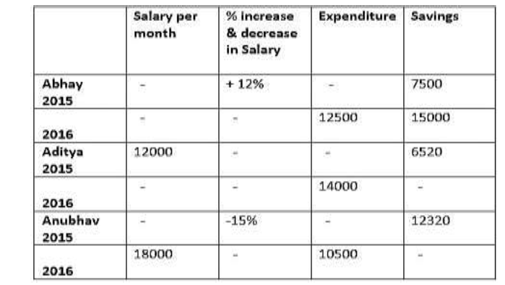
Directions (Q11 to 15): Study the following table carefully and answer the questions below.
Distribution of Salary of Abhay, Aditya and Anubhav over 2015 and 2016:
Q11. What was the approximate salary of Abhay in 2015 and Aditya in 2016 together if saving of Aditya in 2016 is 70% of that in 2015(in Rs.)?
A. 51286
B. 43118
C. 32811
D. 40290
Notes:
Correct Answer: Option B
Level: Moderate (Compulsory)

Slide 13
Directions (Q11 to 15): Study the following table carefully and answer the questions below.
Distribution of Salary of Abhay, Aditya and Anubhav over 2015 and 2016:
Q12. What was the percentage change in Abhay’s
expenditure from 2015 to 2016?
A. 16.5% decrease
B. 26.7% increase
C. 26.7% decrease
D. 16.6% decrease
Notes:
Correct Answer: Option C
Level: Moderate (Compulsory)

Slide 14
Directions (Q11 to 15): Study the following table carefully and answer the questions below.
Distribution of Salary of Abhay, Aditya and Anubhav over 2015 and 2016:
Q13. The percentage increase in the Aditya’s savings from 2015 to 2016 is 30%, then find the percentage increment in his salary from 2015 to 2016?
A. 68.5%
B. 49.9%
C. 87.3%
D. 92.7%
Notes:
Correct Answer: Option C
Level: Moderate (Compulsory)

Slide 15
Directions (Q11 to 15): Study the following table carefully and answer the questions below.
Distribution of Salary of Abhay, Aditya and Anubhav over 2015 and 2016:
Q15. What is the total expenditure of Abhay, Aditya and Anubhav for two years?
A. 68930
B. 42829
C. 21990
D. 68390
Notes:
Correct Answer: Option D
Level: Moderate(Optional)

Slide 16
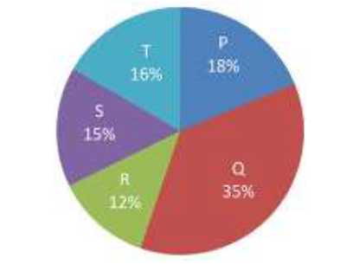
Directions (Q16 to 20): Study the following information carefully and answer the questions given beside:
The following chart shows the percentage purchase of 5 different people P, Q, R, S and T done for upcoming festivals.
Q16. What is the difference between the total purchase of items made by R and T together and the total purchase of items made by P and S together?
237
235
335
245
No. of total items purchased = 4700
Notes:
Correct Answer: Option B
Level: Easy (Compulsory)

Slide 17
Directions (Q16 to 20): Study the following information carefully and answer the questions given beside:
The following chart shows the percentage purchase of 5 different people P, Q, R, S and T done for upcoming festivals.
Q17. What is the ratio of the total purchase made by P, R and T together to that of S and Q together?
23: 25
25: 27
31: 33
13: 15
No. of total items purchased = 4700
Notes:
Correct Answer: Option A
Level: Easy (Compulsory)

Slide 18
Directions (Q16 to 20): Study the following information carefully and answer the questions given beside:
The following chart shows the percentage purchase of 5 different people P, Q, R, S and T done for upcoming festivals.
Q18. If Q pays Rs. 6300 for his total purchase then how much money P has to pay for his purchase?
A. Rs. 1240
B. Rs. 2260
C. Rs. 3644
D. Rs. 3240
No. of total items purchased = 4700
Notes:
Correct Answer: Option D
Level: Easy (Compulsory)

Slide 19
Directions (Q16 to 20): Study the following information carefully and answer the questions given beside:
The following chart shows the percentage purchase of 5 different people P, Q, R, S and T done for upcoming festivals.
Q19. Total purchase made by R is what percent less than the purchase made by S?
A. 10%
B. 15%
C. 20%
D. 25%
No. of total items purchased = 4700
Notes:
Correct Answer: Option C
Level: Easy (Optional)

Slide 20
Directions (Q16 to 20): Study the following information carefully and answer the questions given beside:
The following chart shows the percentage purchase of 5 different people P, Q, R, S and T done for upcoming festivals.
Q20. Find the central angle of the purchase made by S?
A. 45°
B. 54°
C. 67°
D. 50°
No. of total items purchased = 4700
Notes:
Correct Answer: Option B
Level: Easy (Compulsory)

Slide 21
Any Doubts???

